Slide 1

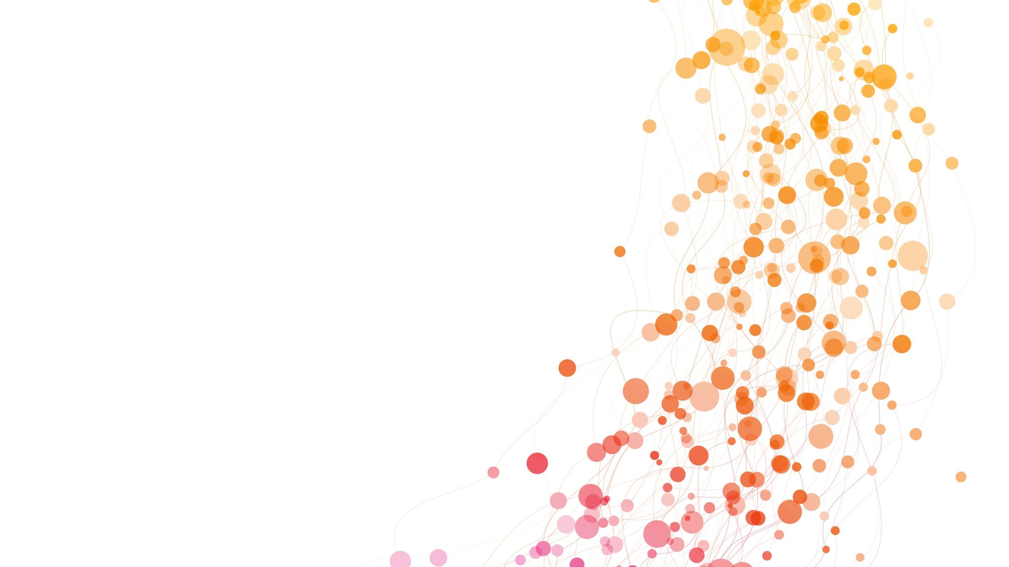
Analysis of Products from Top eBay Sellers
Expecting to be Completed in November 2024
Raman K.

Slide 2

Brief Description
An important part of this project is to develop and demonstrate skills such as:
Web scraping and data collection for creating a database
Data analysis and database management
Creating visualizations for understanding e-commerce dynamics
Raman K.

Slide 3


Working on this project should provide valuable insights about:
📈 Market Trends: Identify which products are trending and popular among top sellers.
🛒 Pricing Strategies: Analyze pricing strategies of successful sellers.
⭐ Customer Preferences: Examine product reviews and ratings to gauge customer satisfaction and preferences.
📦 Product Performance: Compare different product categories to see which perform better in terms of sales volume and customer feedback.
Raman K.

